Slide 1
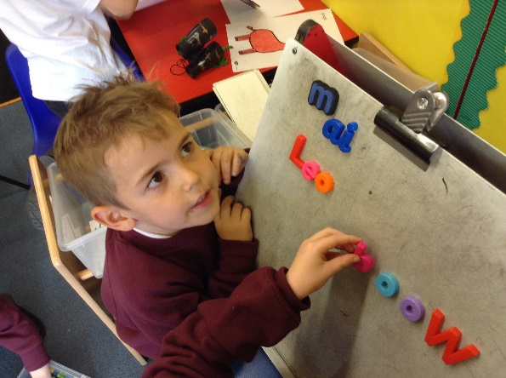
Phonics Workshop for Parents October 2021

Slide 2
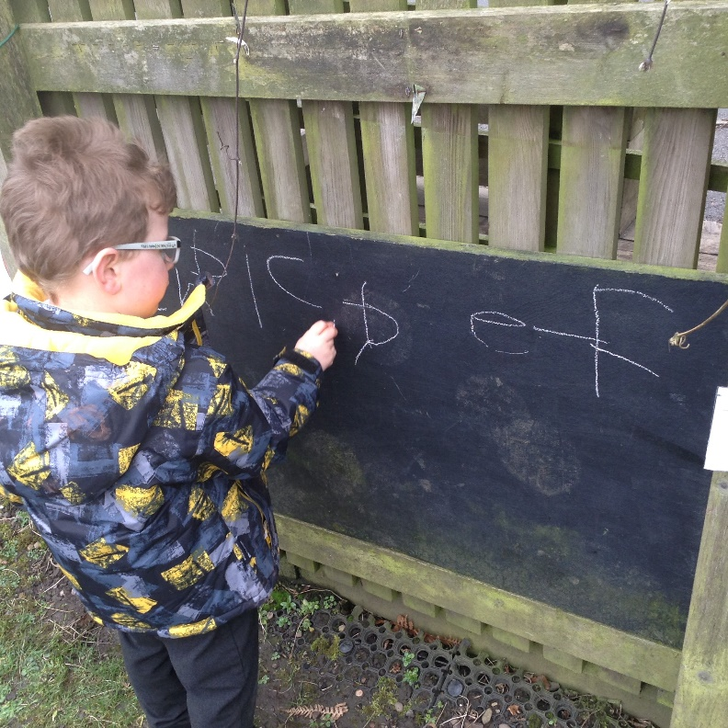
What is synthetic phonics?
Why do we teach phonics?
How it is taught in school
Phonetic vocabulary and
enunciation
How you can help at home

Slide 3
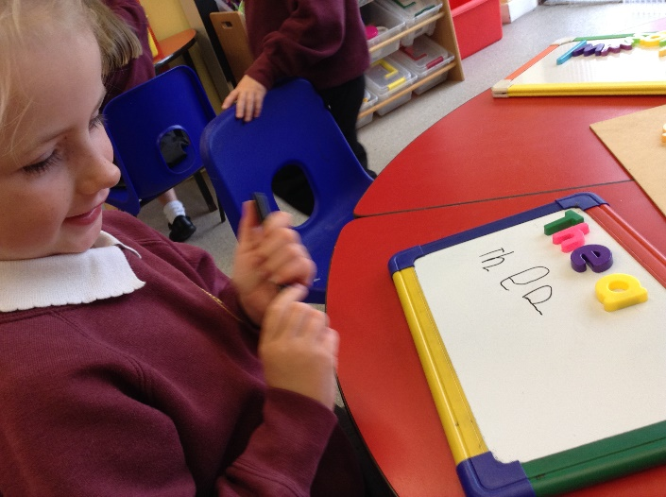
What is synthetic phonics?
Synthetic phonics focuses on the sounds in words. The emphasis on phonics teaching came through a government initiative over ten years ago to improve reading, writing and spelling.
Historically there had been an emphasis on children learning words by rote, familiarising themselves with the whole word using flashcards.
By using the synthetic phonics approach, children learn the individual sounds in words and learn to read and spell using this knowledge.

Slide 4
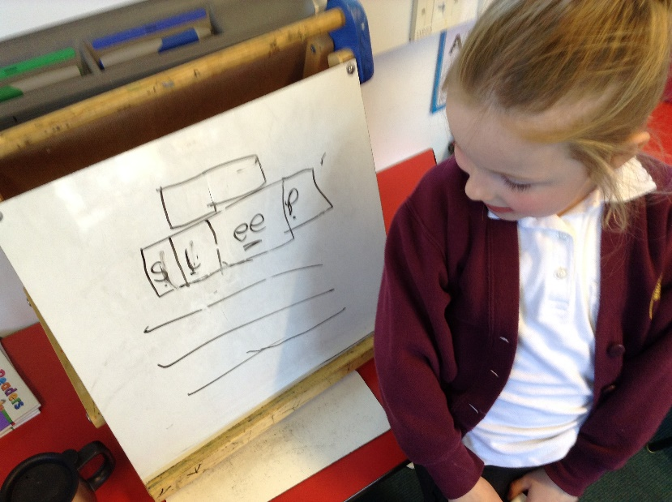
Why teach phonics?
The ability to read and write is a vital skill for all children, paving the way for an enjoyable and successful school experience.
Phonics in the Early Years setting and in Key Stage 1 lays the foundations for a child’s ability to be a confident and proficient reading and speller throughout their school life and beyond.
The careful teaching of phonics and careful assessment can readily identify barriers to learning in those children who show slow progress through the phases.

Slide 5
How is synthetic phonics taught in school?
We follow a phonetic programme called ‘Letters and Sounds’ and use ‘Jolly Phonics’ in Reception to introduce the first sounds, using songs and actions.
Phonics is taught in a series of six phases with each phase building on the skills and knowledge of previous learning. Children are given time to practise and rapidly expand their ability to read and spell words. They are taught to read and spell ‘tricky words’ which are words with spellings that are unusual.

Slide 6
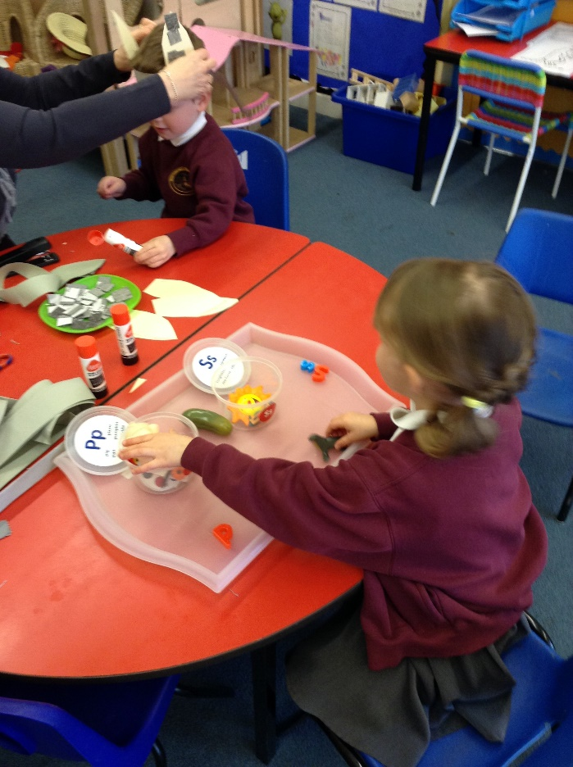
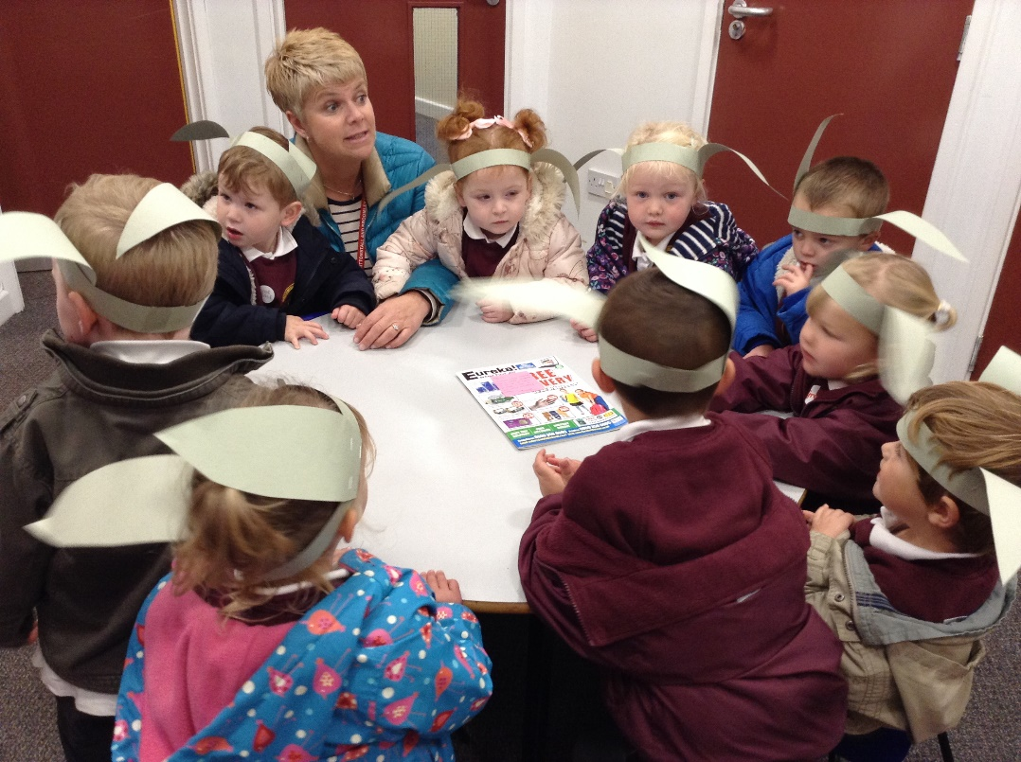
Phase 1
This is taught in Nursery and promotes good listening and speaking skills, with an emphasis on rhyme and alliteration.

Slide 7
Phase 2
Phase 2 is taught in Reception and introduces the first 19 letters and sounds and red tricky words. The emphasis at this phase is to blend and segment.
c-a-t sh-ee-p w-e-t ch-i-m-p
and no go the to

Slide 8
Phase 3
Next 25 letters and sounds with continued emphasis on confident blending and segmenting. Introduction of middle vowel sounds.
w-ai-t sh-ee-t f-oo-d f-oi-l
you was there water

Slide 9
How can I help at home?
Play games that promote hearing sounds such as ‘I spy’. Letter and sounds hunt around home.
Let the children talk to you about the new sounds and actions they have learnt that week.
Practise flashcards and tricky words regularly. ‘Posting box’ idea works well.
Complete phonics colouring sheets. These are to be kept at home, they do not need to be returned to school.
Practise formation of new letters using correct ‘nip, nip’ grip and formation.

Slide 10
Phase 4
In Phase 4, no new graphemes are introduced. The main aim of this phase is to consolidate the children's knowledge and to help them learn to read and spell words which have adjacent consonants, such as trap, string and milk. This phase is introduced towards the end of the Reception year and continues in Autumn term of Year 1.
said like come

Slide 11
Phase 5
Children entering Phase Five will already be able to read and spell words with adjacent consonants, such as trap, string and flask. They will also be able to read and spell some polysyllabic words such as bedroom, buttercup, football.
In Phase Five, children will learn more graphemes and phonemes (letters and sounds). For example, they already know ai as in rain, but now they will be introduced to ay as in day and a-e as in make.

Slide 12
Vocabulary and Enunciation
In Reception the children start to learn the related vocabulary.
Segmenting – ‘chopping up’ the word to spell it out.
Blending – merging sounds in order they are written to pronounce the word.
Phonemes – how it sounds
Grapheme – how it looks
Polysyllabic – softest, pondweed, windmill, melting etc.
Adjacent consonants – grab, bend, scrap etc.
Split digraph – smile, side, fume, flute etc.

Slide 13
Digraphs – 2 letters that make a sound
ll ss zz oa ai
Trigraphs – 3 letters that make 1 sound
igh ear ure air

Slide 14
Enunciation
There are 44 phonemes and saying them correctly is extremely important. The way we say them may well be different from when you were at school. We say the shortest form of the sound.
m t c p

Slide 15
Year 1 Phonics Screening
The Phonics Screening Check is meant to show how well your child can use the phonics skills they’ve learned up to the end of Year 1, and to identify students who need extra phonics help. The Department for Education defines the checks as “short, light-touch assessments” that take about four to nine minutes to complete.
The checks consist of 40 words and non-words that your child will be asked to read one-on-one with a teacher. Non-words (or nonsense words, or pseudo words) are a collection of letters that will follow phonics rules your child has been taught, but don’t mean anything – your child will need to read these with the correct sounds to show that they understand the phonics rules behind them.

Slide 16
The context of ‘alien word’ is often used
thrand shrowb groang

Slide 17
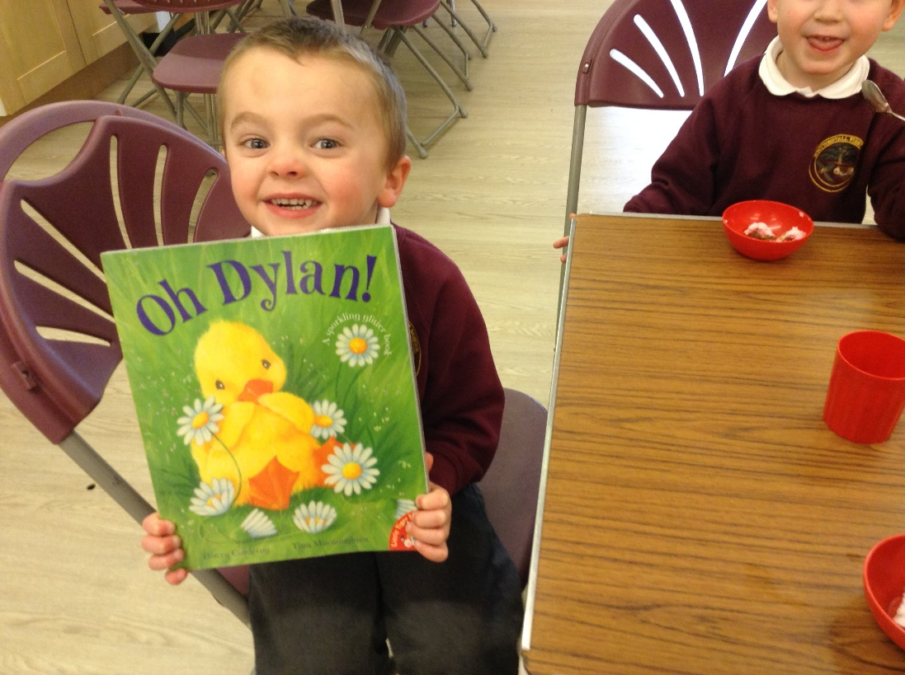
How can you help at home?
Regular flashcard rapid recall and reading at home is so important in building confidence and fluency.
Encourage them to:
Sound out
Re-read to check it makes sense
Use pictures for clues
Ask questions about the book
And most importantly ENJOY READING!

Slide 18
Useful website addresses and apps
www.phonicsplay.co.uk
www.twinkl.co.uk
www.oxfordowl.co.uk

